Slide 1

OLYMPIC GAMES MEDAL Prediction (TOKYO 2020)
BY:
SHANTHI
DATA ANALYST
STATSCORP PTE LTD

Slide 2
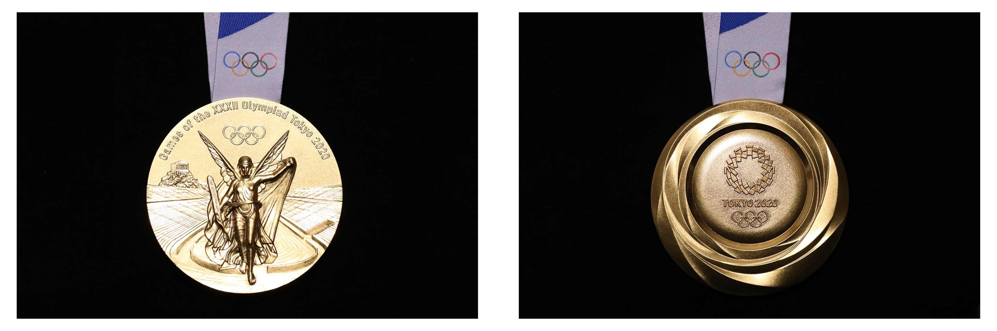
Objective :
To Predict Medal count for Olympics 2020.
To Rank countries based on Medals.
Target Audience :
Olympic Committee from Participating Countries
Use-Case:
Helps organisation to Analyse & Plan the Winning strategy, Better Decision Making, Fund Allotment for Training, etc
Tokyo 2020 Medals designed by Junichi Kawanishi

Slide 3
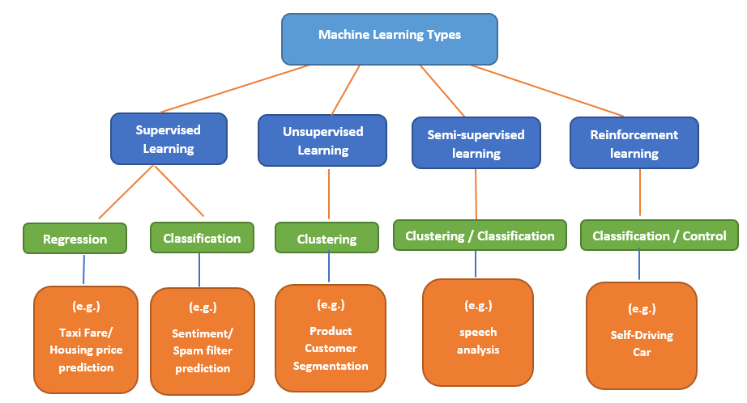

Methodology :
Goal : To Build a Machine Learning Model to Predict Medals (Gold, Silver, Bronze) as accurate as possible
Base Model : Linear Regression
Alternate Models : Support Vector Machine
Decision Tree
Random Forest , KNN, SVM
Metrics : R^2 Score
Tools :

Slide 4
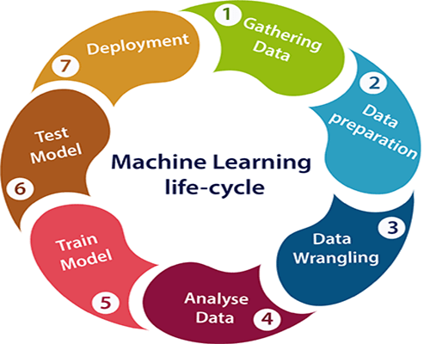
Machine Learning Life-cycle :

Slide 5
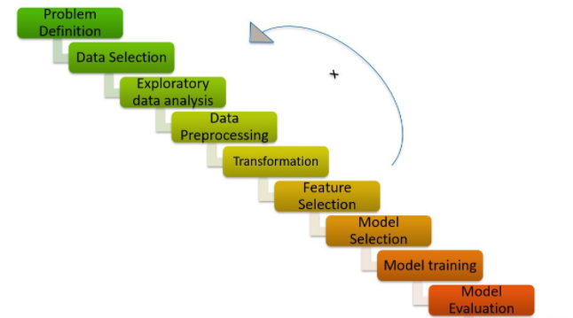
Process Worflow :
Process workflow :

Slide 6
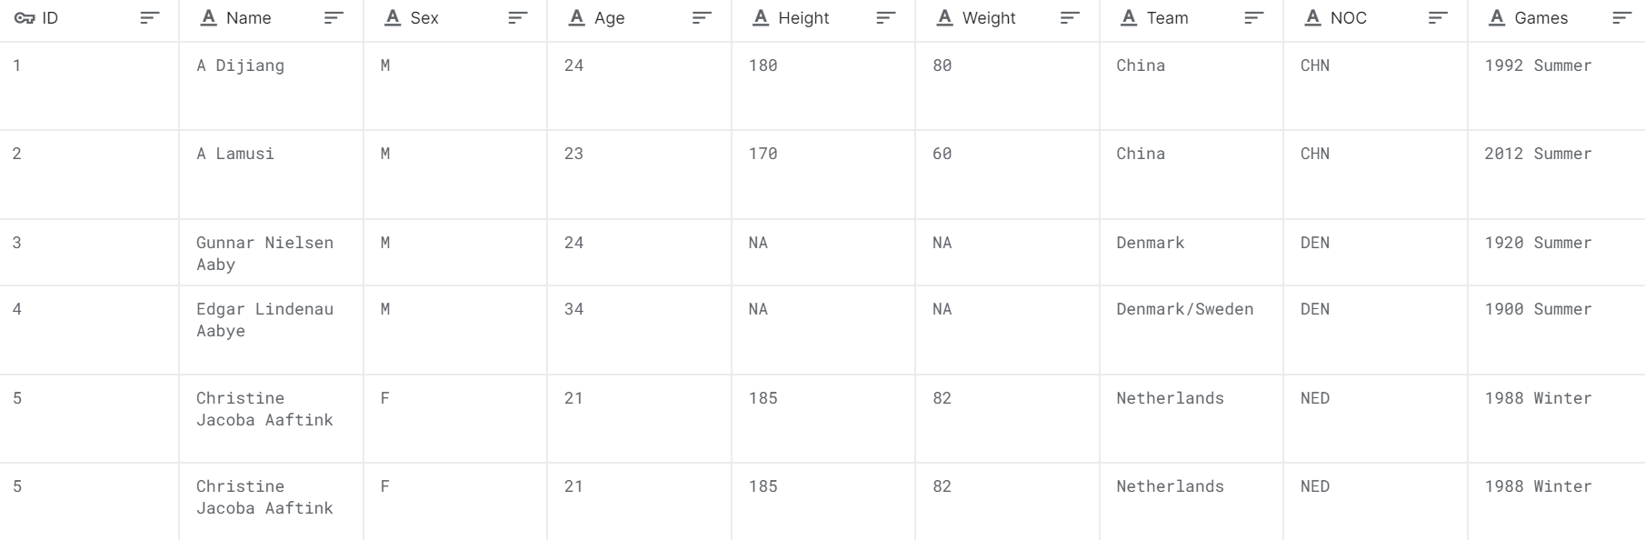
Data selection :
Source: Kaggle
271,116 observations (athletes) and 15 columns
Dataset: tinyurl.com/ycbukz5w

Slide 7
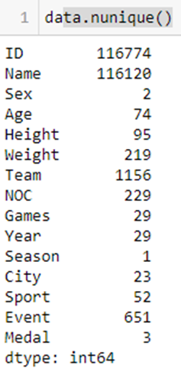
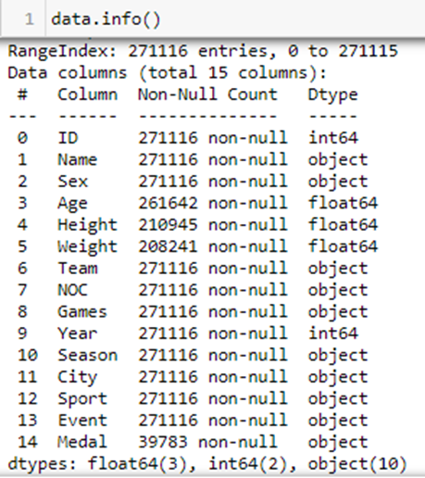
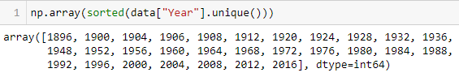
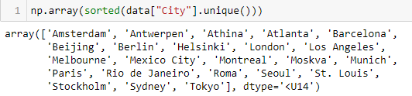
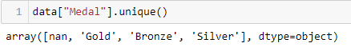
Exploratory data analysis(EDA):
271,116 Athlete Record/Data (with traits)
29 years of Data(1896 – 2016)
23 unique ‘Host City’
651 unique ‘Events’
229 ‘Countries’
Medals – ‘Gold’, ‘Silver’, ‘Bronze’, ‘Null’(No Medal)

Slide 8
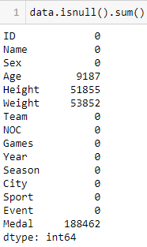
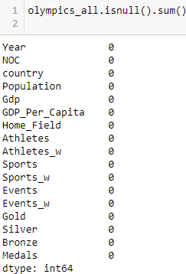
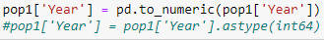
data Preprocessing:
Athletes + Medal
Country Names
Host Country
Preprocessing
Population
GDP
merge, concat, groupby, melt, where, astype, getdummies, drop, isnull
AFTER
BEFORE

Slide 9
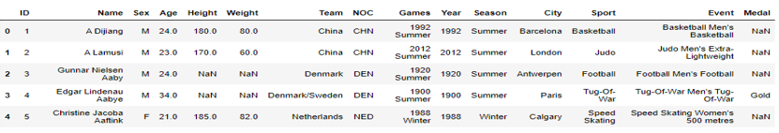
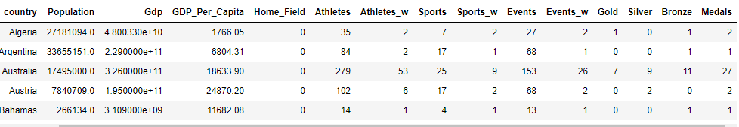
Transformed Data :
Before :
After :
Columns Added : Country, Population,Gdp, Gdp_per_capita, Home_field, Gold, Silver, Bronze, Athletes_w, Sports_w, Events_w

Slide 10

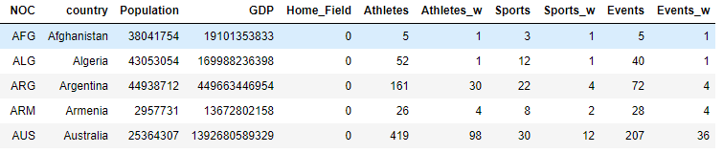
Olympics 2020 DATASET :
Apply mean value for Athletes, Sports & Events
Added latest GDP and Population(2020-2021)
CODE :
OUTPUT :

Slide 11
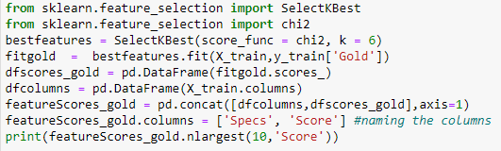
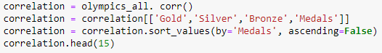
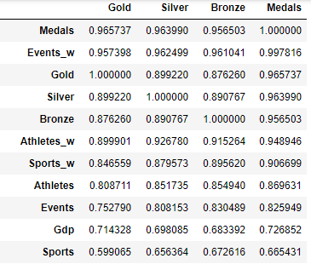
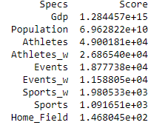
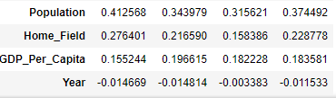
feature selection :
SelectKBest
Correlation :
Output
Output : Top Features

Slide 12
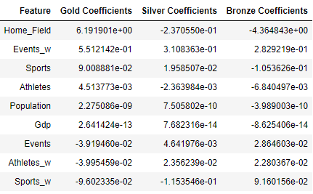
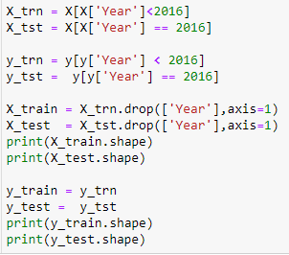
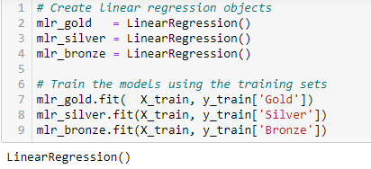
BASE MODEL : LINEAR REGRESSION
Training set Data : Year 1992 – 2012 (more countries, more sports, events & female participants)
Test set Data : Year 2016
Models : 3 Models each (Gold, Silver, Bronze) & then find the Total Medal Count
Features : Population, GDP, Home_Field, Athletes, Sports, Events, Athletes_won, Sports_won, Events_won

Slide 13
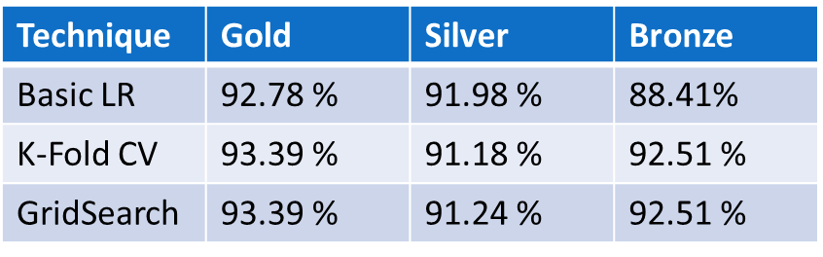
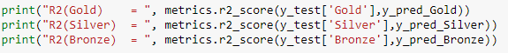
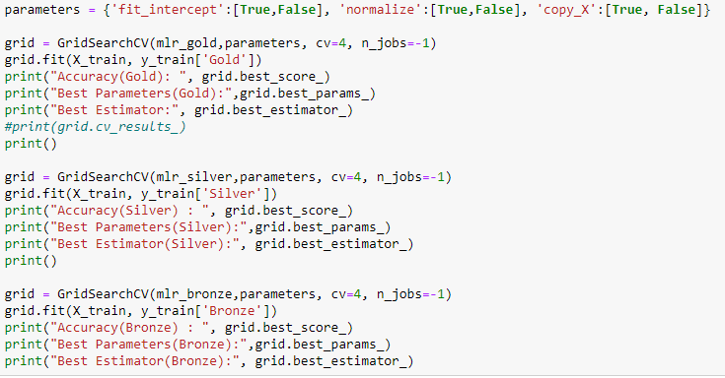
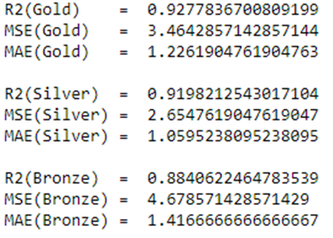
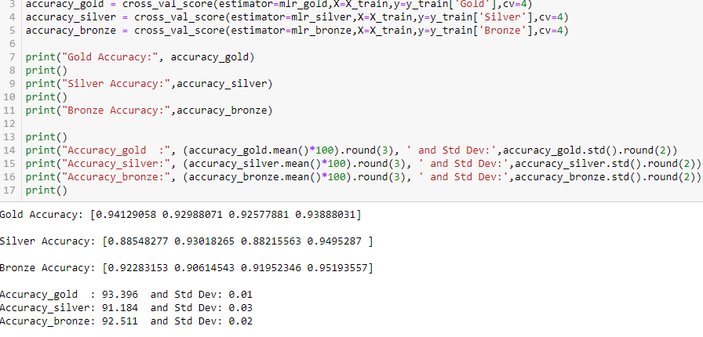
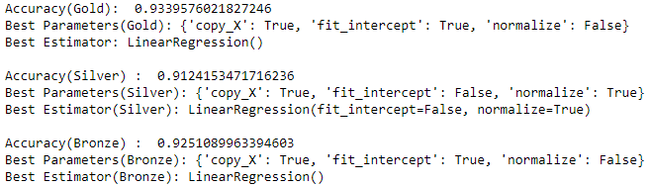
Accuracy Score(R^2) : Linear Regression
Basic Model Accuracy :
Hyperparameter Tuning – GridSearchCV
K-Fold Cross Validation :

Slide 14
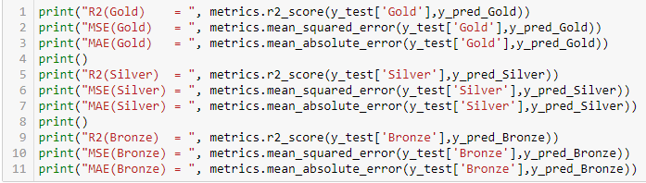
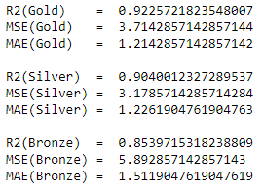
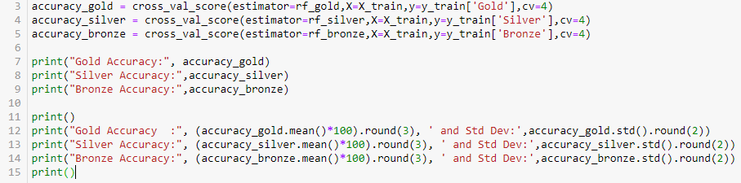
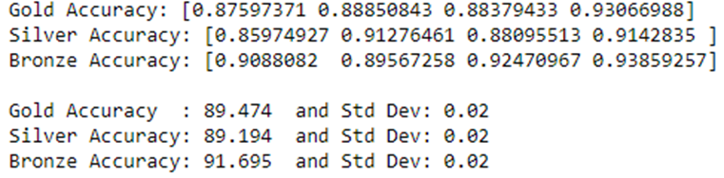
RANDOM FOREST REGRESSOR :
RF BASIC MODEL :
K-Fold Cross Validation :

Slide 15
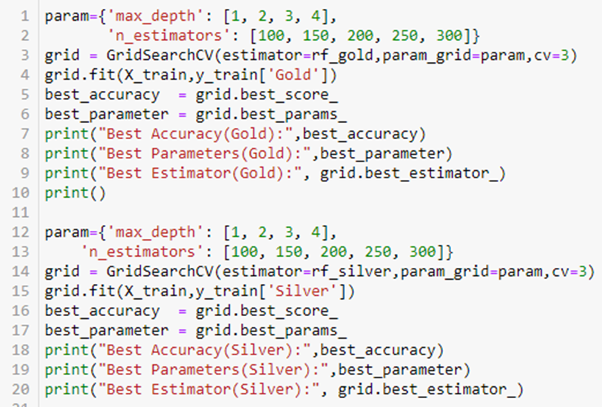
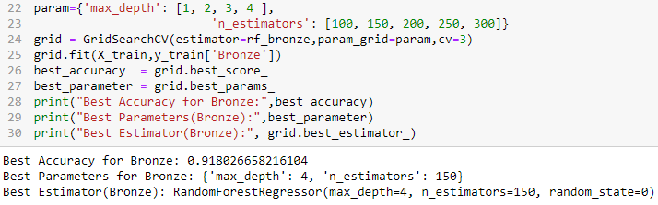
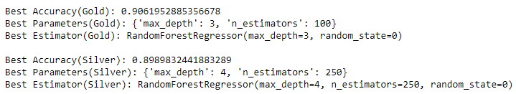
RANDOM FOREST REGRESSOR
GridSearchCV
Accuracy Score for RandomForest :
Technique | Gold | Silver | Bronze
Basic RdFr | 92.25 % | 90.40 % | 85.39%
K-Fold CV | 89.47 % | 89.19 % | 91.69 %
GridSearch | 90.61 % | 89.89 % | 91.80 %

Slide 16
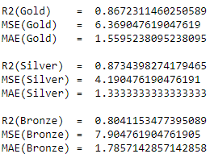
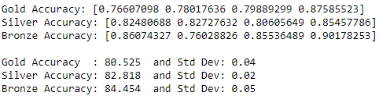
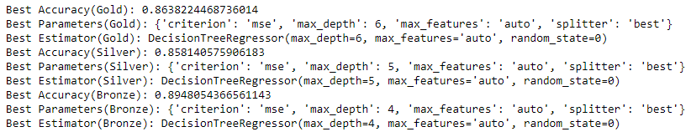
Decision Tree Regressor
Model | Gold | Silver | Bronze
Decision Tree | 86.72 % | 87.34 % | 80.41 %
K-Fold CV | 80.52% | 82.82 % | 84.45 %
GridSearchCV | 86.38 % | 85.81 % | 89.48 %
R^2 Score K-Fold CV
GridSearchCV

Slide 17
Evaluating the Models : Comparison
K-NN
Support Vector Machine Regressor
Technique | Gold | Silver | Bronze
Basic K-NN | 63.42 % | 50.53 % | 61.79%
K-Fold CV | 33.03 % | 40.69 % | 35.40 %
GridSearch | 41.85 % | 45.57 % | 43.90 %
Technique | Gold | Silver | Bronze
Basic SVR | 36.25 % | 38.98 % | 44.16%
K-Fold CV | 21.43 % | 28.67 % | 33.07 %
GridSearch
Comparing All Models:
Model | Gold | Silver | Bronze
Linear Regression | 93.39 % | 91.24 % | 92.51 %
Random Forest | 90.61 % | 89.89 % | 91.80 %
Decision Tree | 86.38 % | 85.81 % | 89.48 %
K-NearestNeighbours | 41.85 % | 45.57 % | 43.90 %
Support Vector | 21.43 % | 28.67 % | 33.07 %

Slide 18
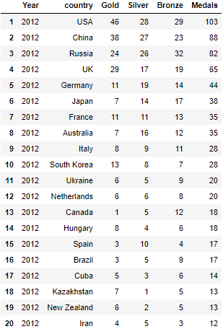
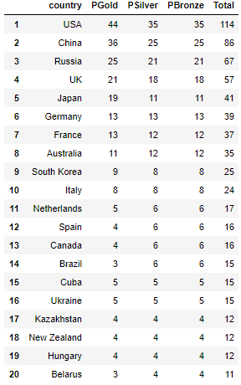
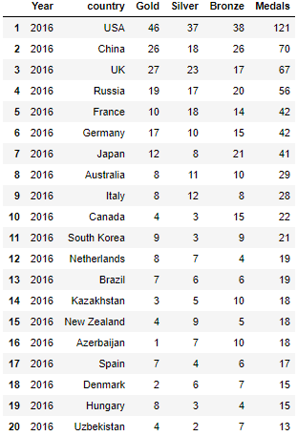
Prediction : Applying Linear Regression to predict 2020 Medal count
Insights:
Japan in TOP 5, gets big boost in gold medals (Home Ground Advantage - 6% higher chance)
Top 4 Countries remain the same
Expecting china to perform better in 2020 than 2016
2012 Actual (London)
2020 Prediction (Tokyo)
2016 Actual(Brazil)

Slide 19
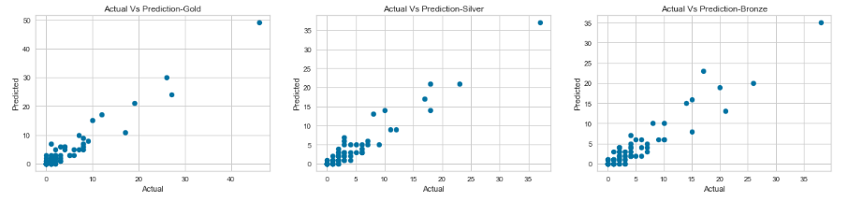
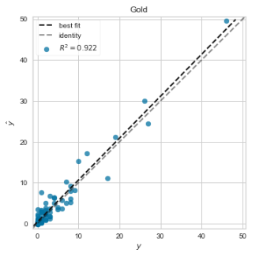
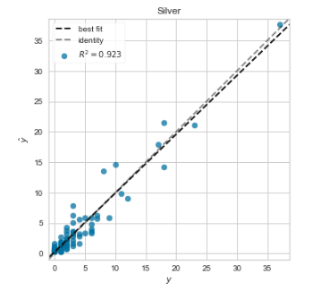
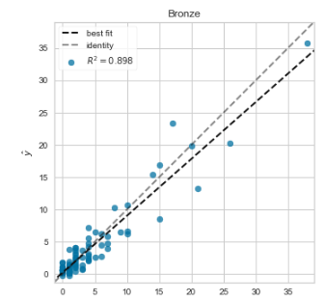
ACTUAL VS PREDICTION
Olympics 2020 DATA :
Yellowbrick.regressor PredictionError

Slide 20

Olympics 2020 Medal PREDICTION - COMPARING MY model
Rank
1
2
3
4
5
6
7
8
9
10
Gracenote.com
United States | 114
China | 85
Russia | 73
Japan | 59
Netherlands | 46
France | 41
Australia | 40
UK | 36
Germany | 34
Italy | 33
My ML Model
United States | 114
China | 86
Russia | 67
UK | 57
Japan | 41
Germany | 39
France | 37
Australia | 35
South Korea | 25
Italy | 24

Slide 21

THE UNEXPECTED :
Most Unpredictable Olympic Games ever.
COVID-19 pandemic - Unknown effect on medals?
Game delayed by a year – Is it going to help Athletes?
New Sports(surfing, sport climbing, skateboarding, baseball, karate) & Extra Events introduced - Increased medal count, more likely for top countries
No Overseas Spectators – Good or Bad?

Slide 22
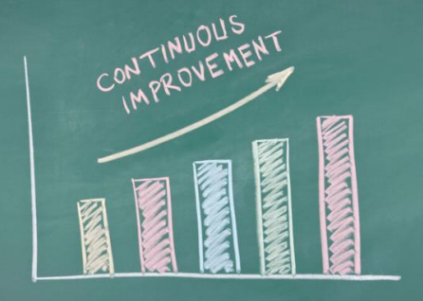
RECOMMENDATION TO IMPROVE THE MODEL
Try Include Athletes Traits (Height, Weight, Gender, Age)
Include Geographic, economic, and political factors
Include Athletes Performances from other competitions
Try to account for the unexpected
CONCLUSION
Hope this helps, Sports organizations achieve Target at minimum effort
Watch the Games
Compare my model with the actual

Slide 23

Thank you

